Slide 1
SESSION 34B
Multimodal RAG
Image and text retrieval · CLIP embeddings in RAG · then we build one
COMPUTER VISION & AI SERIES
THEORY + PRACTICAL
DURATION
Phase 9 — RAG Systems
Slides, then the notebook
~15 min slides + 30 min lab
Notebook: Session34_Multimodal_RAG_Practical.ipynb

Slide 2
THE PROBLEM
Text-only RAG throws away the answer
Where the answer actually lives
What your Session 33 pipeline did to it
A 10-K answers "what drove the margin decline?" with a
waterfall chart on page 34 — no sentence says it.
A wiring diagram answers "which valve connects to the
pressure relief line?" No paragraph does.
pypdf extracted the text and silently dropped every
figure. Merged-cell tables linearised into nonsense.
Captions were indexed without their figure.
The pixels were never in the index at all.
The symptom you will actually see in production
The model answers "I don't have enough information" for a page you know you indexed — or worse, it
fabricates a number, because the retrieved chunk only paraphrased a table. This is a ceiling that no
amount of chunk-size tuning can lift, because the information was lost before chunking began.
Session 34b · Multimodal RAG

Slide 3
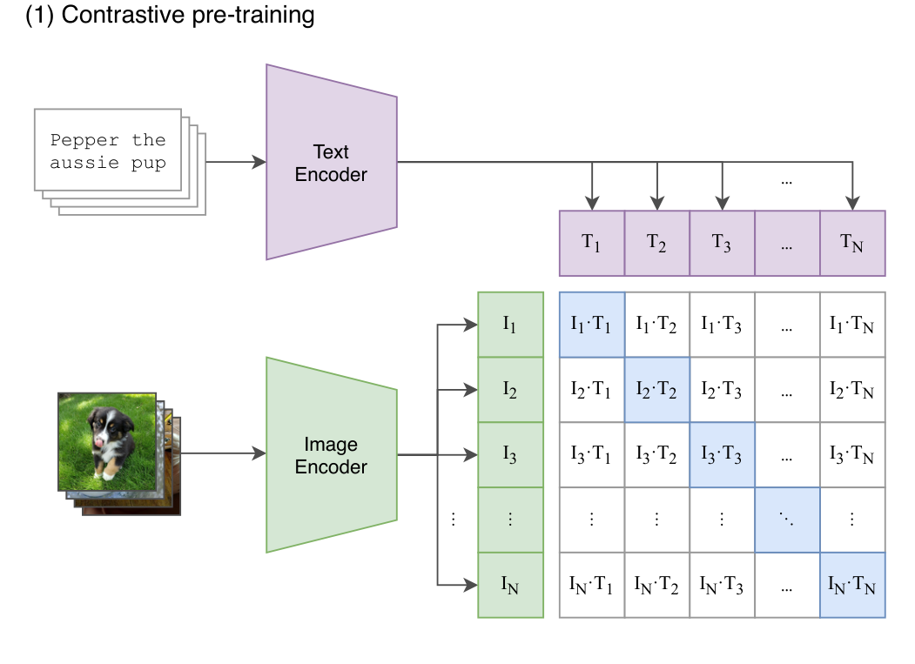
WHAT CLIP GIVES US
One vector space, two kinds of input
Session 26, in three lines
Two encoders, trained on 400M image–caption pairs,
to put matching pairs close together and everything
else far apart.
The output is one shared space. An image of a dog and
the string "a photo of a dog" land near each other, so
a dot product is a meaningful comparison across
modalities.
The RAG consequence: you no longer need a caption to
find an image. The image is its own searchable object.
Source: Radford et al. (2021), arXiv:2103.00020, Figure 1, panel 1. Reproduced with attribution.
Session 34b · Multimodal RAG

Slide 4
CROSS-MODAL RETRIEVAL
Four query paths, one index
Query → Result
What it is called
Where you have seen it
text → text
Ordinary dense retrieval
Everything in Sessions 32–34a
text → image
Text-to-image search
"Show me the chart of Q3 revenue"; stock photo search
image → text
Image captioning by retrieval
Reverse lookup: which passage describes this figure?
image → image
Visual similarity search
"Find products that look like this"; near-duplicate detection
Why this is so little extra machinery
What still has to be decided
Same FAISS index. Same cosine metric. Same top-k.
The only change is which encoder produced the
vector — and a `modality` field on the record.
Whether text and images share one index or two,
and how you merge their rankings. We use two legs
and fuse with RRF — the same line as Session 34a.
Session 34b · Multimodal RAG

Slide 5
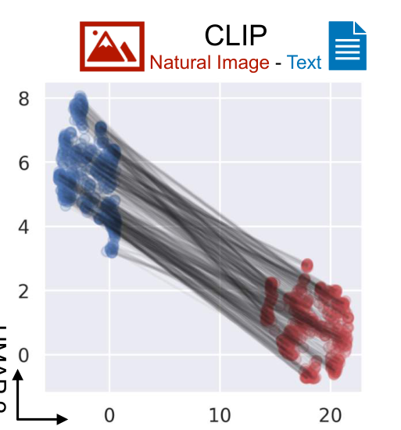
THE CATCH: THE MODALITY GAP
The shared space is not actually shared
What you are looking at
Why it bites in RAG
A UMAP of paired CLIP embeddings.
Blue points are images, red points
are their own captions, and the grey
lines join each matching pair.
They should be interleaved.
They are not: the two modalities sit
in two separate cones.
Any image scores higher against
any other image than against its
own caption.
So a single ranked list mixing text
and image hits is dominated by
whichever modality the query
came from. Absolute scores are
not comparable across modalities.
Source: Liang et al. (2022), arXiv:2203.02053, Fig. 1(b), CLIP panel (NeurIPS 2022).
Practical response: fuse by rank (RRF), never by raw score — or use a gap-closing model such as SigLIP 2 or Jina v4.
Session 34b · Multimodal RAG

Slide 6
THREE ARCHITECTURES THAT WORK IN 2026
Pick by what a wrong answer costs you
Architecture
How it works
Strength
Weakness
Caption-and-index
A VLM captions each image; the caption is embedded as text
Simplest. Reuses your existing text pipeline
Lossy. A hallucinated caption pollutes the index
Unified embeddings
Text and images encoded into one space (CLIP, SigLIP 2, Cohere Embed 4, voyage-mm)
One index, cross-modal queries, one vector per item
Coarser than late interaction. API cost or self-hosted GPU
Page-as-image + late interaction
Render the whole page; embed patches (ColPali, ColQwen2.5)
Highest recall on figure-heavy documents. No parsing pipeline
~1,000 vectors per page. Needs MaxSim scoring
We build architecture 2 in the lab: it is the one that teaches the underlying idea, runs on a CPU, and costs nothing.
By 2026 single-vector models are competitive with ColPali on most enterprise corpora at a fraction of the storage.
Session 34b · Multimodal RAG

Slide 7
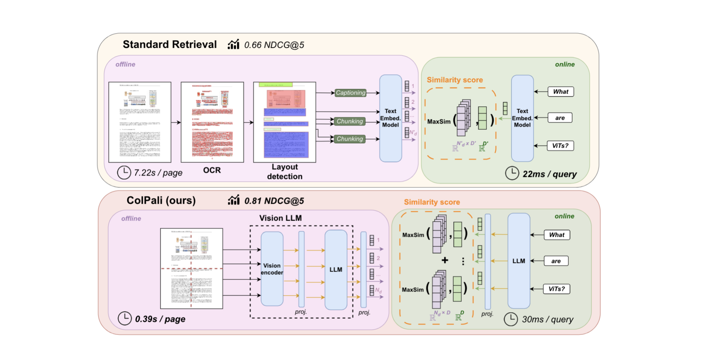
WHERE THIS GOES NEXT: COLPALI
Skip parsing entirely and embed the page
Read the two clocks
Standard retrieval: OCR, layout
detection and captioning —
7.22 s per page, 0.66 NDCG@5.
ColPali: render the page and
embed it with a vision LLM —
0.39 s per page, 0.81 NDCG@5.
The parsing pipeline was both
the slow part and the lossy part.
Cost: ~1,000 patch vectors per
page instead of one.
Source: Faysse et al. (2024), arXiv:2407.01449, Figure 1 (ICLR 2025). Reproduced with attribution.
Session 34b · Multimodal RAG

Slide 8
GENERATION WITH A VISION MODEL
Retrieval finds the figure; the prompt decides
The prompt pattern that works
Chart hallucination — the failure to plan for
"Here are the relevant pages and figures. Answer
using only what is visible in them. For any numerical
answer, cite the specific figure or table. If the
answer is not there, say so."
"Cite the specific figure" measurably reduces
hallucination: it forces the model to point at a
concrete source instead of gesturing at the context.
Vision models misread axis scales, confuse legend
colours, and invent precise numbers when the
resolution is poor or the labels are tight.
Mitigations: ask for a short reasoning chain; cross-
check numbers against structured data extracted at
parse time; treat hedged answers as a signal for
human review.
Budget it: a 1024×1024 image costs roughly 765–1,600 input tokens depending on the provider. Five pages is not free.
Session 34b · Multimodal RAG

Slide 9
WHAT WE ARE ABOUT TO BUILD
End to end, on real figures from real papers
1 · Extract
figures out of arXiv PDFs
2 · Embed
CLIP for images, CLIP text for chunks
3 · Index
two FAISS legs, one metadata store
4 · Retrieve
cross-modal search + RRF fusion
5 · Generate
vision model reads figure + text
The questions the lab answers
What you leave with
• Does a text query actually find the right figure?
• How much worse is caption-only retrieval?
• What does the modality gap look like in numbers?
• Does the answer change when the figure is
included in the prompt versus text alone?
A multimodal index over papers you chose, a
cross-modal search function, an RRF fusion of the
text and image legs, and a grounded answer that
cites both a passage and a figure.
CLIP and FAISS run locally on CPU; only the text
embeddings and generation are paid calls.
Session 34b · Multimodal RAG

Slide 10
RECAP
Five things to remember
1
Text-only RAG has a hard ceiling on figure-heavy documents.
The information is lost at ingestion, before any chunking decision is made.
2
CLIP's contribution is one shared space, not one model.
That is what lets a text query retrieve an image without a caption in between.
3
The shared space is not evenly shared.
The modality gap means raw cross-modal scores are not comparable. Fuse ranks, not scores.
4
There are three architectures, not one.
Caption-and-index, unified embeddings, page-as-image. Cost and recall differ by an order of magnitude.
5
Vision models hallucinate charts.
Prompt for figure-level citations and build a small chart-QA eval set before you scale.
Now open Session34_Multimodal_RAG_Practical.ipynb.

